Slide 1
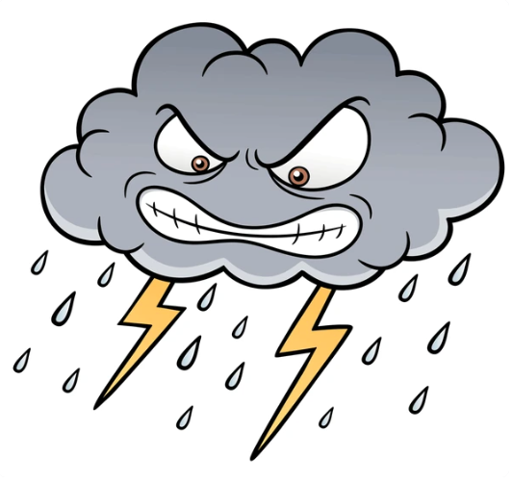


Indiana University Bloomington
Analyzing Extreme Precipitation Events in Bloomington Using Generalized Extreme Value Regression
Current and Future Trends in Extreme Weather (Fall 2024)
Graduate Major Assignment
Student: Guoqing Gong
Teacher: Travis O’Brien
Notes:
Hello everyone, today's video focuses on analyzing the extreme precipitation and flood events of June 2021 in Bloomington using the Generalized Extreme Value (GEV) regression.

Slide 2
Analyzing Extreme Precipitation Events in Bloomington Using Generalized Extreme Value Regression
Contents
News on extreme precipitation and flooding in Bloomington 2021
The causes of this event
Historical trend in extreme precipitation and methods
The impact of human activities on extreme precipitation
Future changes in extreme precipitation
Historical records of extreme precipitation and flooding in Bloomington 2021
Generalized Extreme Value (GEV) Regression
Return interval and risk ratio of the event
Discussion and Compared to the period 1895-2022
Summary
Notes:
The presentation will talk about:
Background of the Bloomington extreme precipitation event
Past extreme precipitation events
Impact of human activities
Future extreme precipitation events
Using GEV to analyze the Bloomington extreme precipitation event

Slide 3
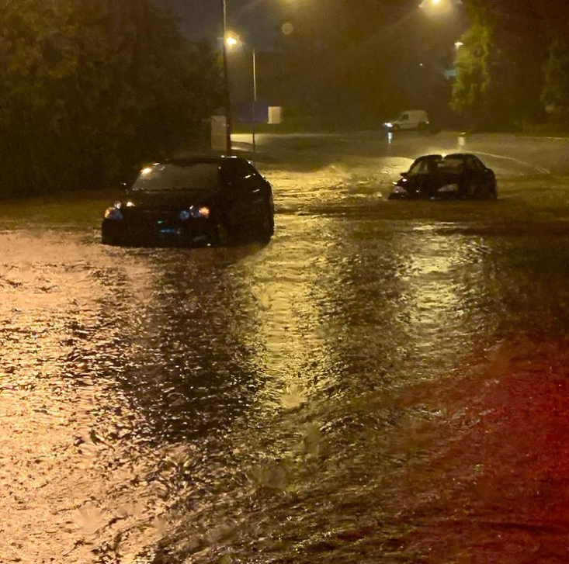
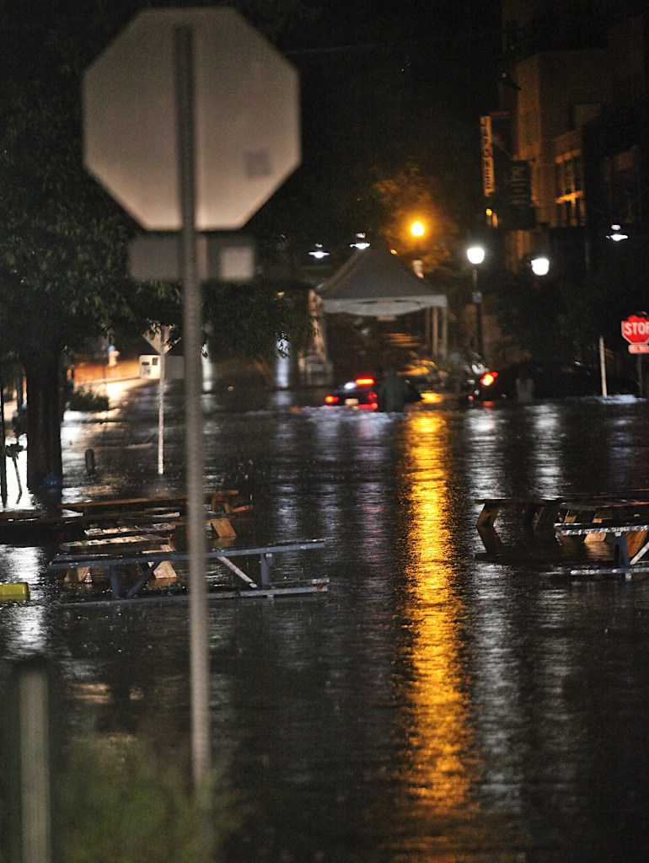
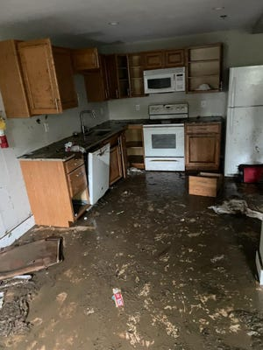
Analyzing Extreme Precipitation Events in Bloomington Using Generalized Extreme Value Regression
News on extreme precipitation and flooding in Bloomington 2021
(Askins, D., 2021; Richard, D., 2021)
Precipitation intensity
Two-day rainfall reached 6.1 inches
Strongest precipitation event in a century
Impact of the event
Caused severe flooding
Power outages
Streets and apartments inundated
Bridges submerged by gravel
Cars swept away by floodwaters
Economic losses
Casualties
…
Notes:
On June 18th and 19th, 2021, Bloomington experienced an extreme precipitation event that led to severe flooding. According to measurements from a station at Indiana University, the two-day rainfall reached 6.1 inches, setting a record for the highest 2day precipitation in a century.
From the picture, it is evident that the floods caused by this extreme rainfall led to power outages, with streets and apartments submerged, cars swept away by the waters, and even resulted in the death of a driver.

Slide 4
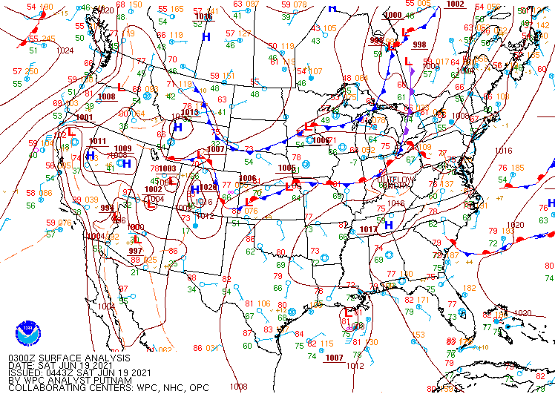
Analyzing Extreme Precipitation Events in Bloomington Using Generalized Extreme Value Regression
The causes of this event
(NOAA, 2021)
Mesoscale Convective System
Quasi-stationary front
High instability in the atmosphere
Temperatures above normal
Strong south winds
Stronger moisture transport from the ocean
Thunderstorms
Multiple rounds
Intense rainfall rates
”Training" pattern
Notes:
The flooding happened because of a lot of precipitation from a big storm system called a Mesoscale Convective System (MCS), which was stuck in one place because of a nearly stationary weather front. On the night of June 18th, this storm system got stronger and didn't move, so it caused a huge thunderstorm over Bloomington, that lasted more than eight hours into the next day. During this time, several smaller storm cells kept forming and moving over the same area again and again (Travis, 2021).

Slide 5
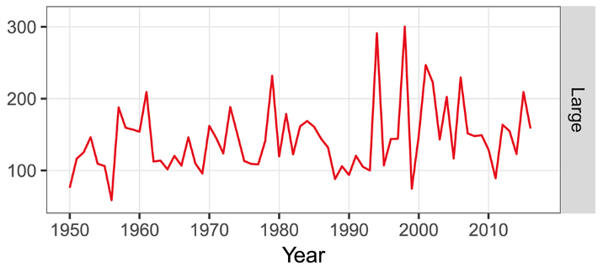
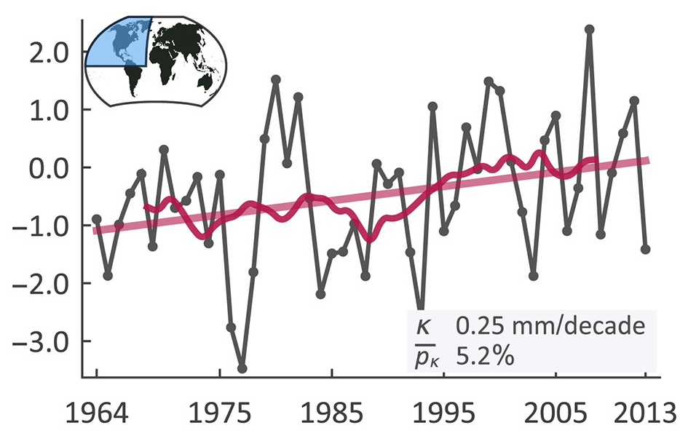
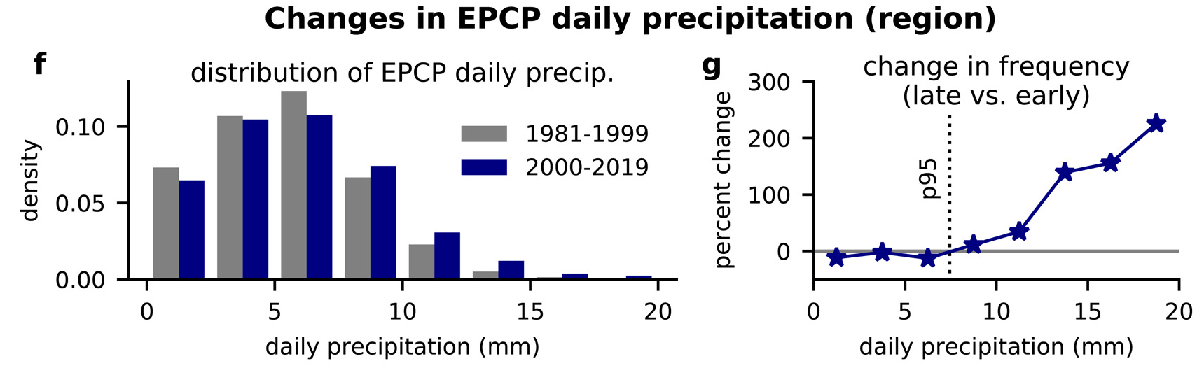
Analyzing Extreme Precipitation Events in Bloomington Using Generalized Extreme Value Regression
Historical trend in extreme precipitation and methods
(Risser and Wehner, 2017, GRL)
Historical trend
Increased trends in extreme precipitation are observed across various datasets and methods
Methods
Linear Regression
Machine Learning
GEV Regression
Rx7day (mm)
Fig. Time series of 7-day maximum precipitation.
(Davenport et al., 2021, GRL)
(Papalexiou et al., 2019, WRR)
Daily extreme precipitation
anomaly (mm)
Year
Fig. Time series of daily extreme precipitation anomalies in North America.
Fig. Changes in precipitation caused by extreme precipitation circulation patterns during two periods.
Notes:
These three figure show different things about extreme precipitation. The first one shows the trend of 7day precipitation. The second one shows the trend of daily extreme rainfall anomalies. The third one compares changes in extreme precipitation between two different periods.
Research shows that climate change is making extreme precipitation more common and more intense all over the United States (IPCC, 2021). It could even make this kind of event over three times more likely than before (Risser and Wehner, 2017). Also, studies suggest that in the Midwest, the extreme precipitation is getting worse and happening more often.

Slide 6
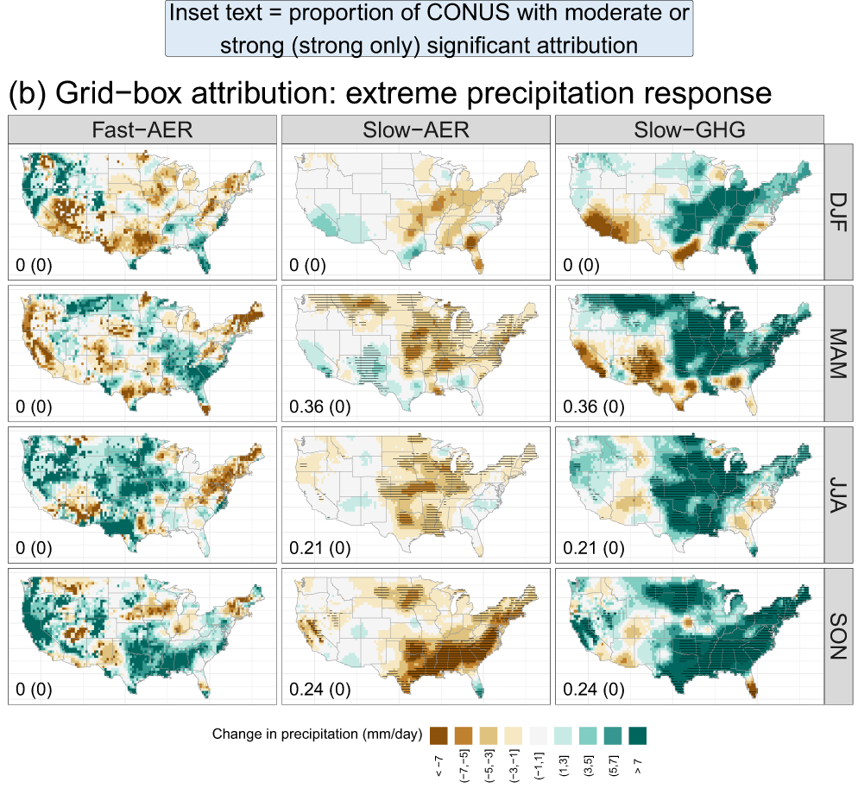
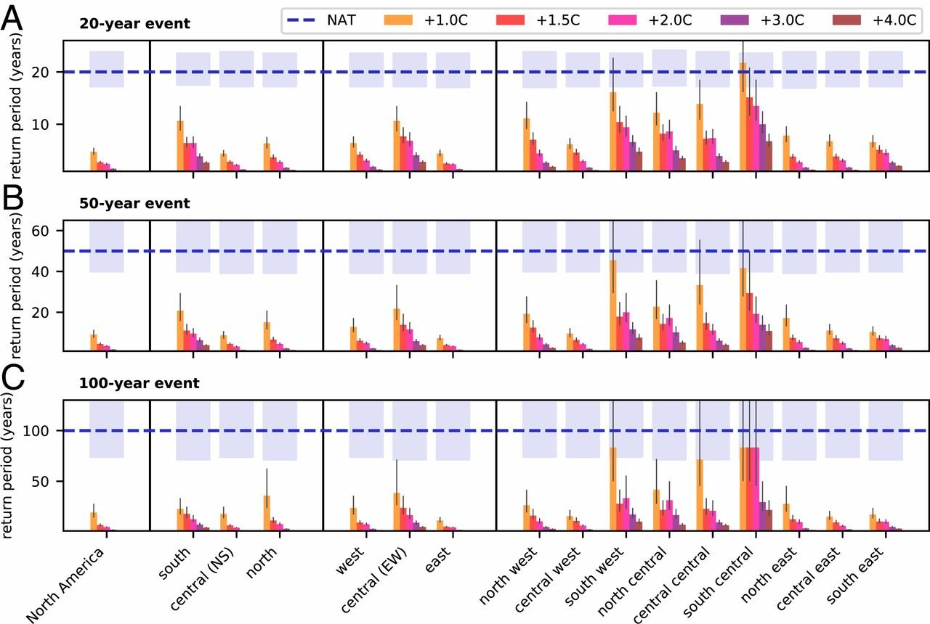
Analyzing Extreme Precipitation Events in Bloomington Using Generalized Extreme Value Regression
The impact of human activities on extreme precipitation
Anthropogenic attribution of extreme precipitation
The anthropogenic signal is strongest for the GHG influence of extreme daily precipitation
The response of slow-aerosols to extreme precipitation is negative almost everywhere.
The response of fast-aerosols to precipitation exhibits a seasonal pattern
Human activities have shortened the return periods of extreme precipitation.
(Kirchmeier-Young et al., 2020, PNAS)
20-year event
50-year event
100-year event
Return Periods (years)
Return Periods (years)
Return Periods (years)
(Risser et al., 2024, Nat Commun)
Fig. Grid-box attribution for the fast aerosol (Fast-AER), slow aerosol (Slow-AER), and greenhouse gas (Slow-GHG) precipitation responses.
Fig. Return periods for Rx1day 20-y (A), 50-y (B), and 100-y (C) events in North America
Notes:
Human activities, like releasing greenhouse gases and aerosols into the air, have really changed the way it precipitation.
The left figure shows the contributions to precipitation from different human emissions, including fast-aerosols, slow-aerosols, and greenhouse gases in different season, with green indicating an increase in precipitation. The right figure shows how the return intervals of extreme events change under different future temperature increases.
Research shows that these human activities are making extreme precipitation events more intense. For example, greenhouse gases are causing more extreme rain each day, while slow-raerosols mostly have a negative effect, and fast-reacting aerosols change how they impact the weather depending on the season and area. These changes have made what used to be rare, once-in-a-hundred-years events happen every 20 years now, making them five times more likely to occur.

Slide 7
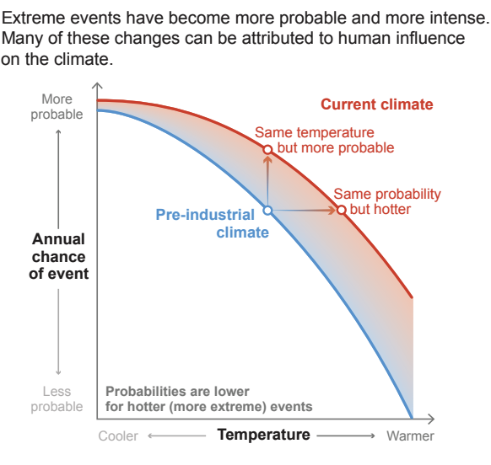
Analyzing Extreme Precipitation Events in Bloomington Using Generalized Extreme Value Regression
The impact of human activities on extreme precipitation
Anthropogenic attribution of extreme precipitation
The anthropogenic signal is strongest for the GHG influence of extreme daily precipitation
The response of slow-aerosols to extreme precipitation is negative almost everywhere.
The response of fast-aerosols to precipitation exhibits a seasonal pattern
Human activities have shortened the return periods of extreme precipitation.
(Kirchmeier-Young et al., 2020, PNAS)
20-year event
50-year event
100-year event
Return Periods (years)
Return Periods (years)
Return Periods (years)
Fig. Changes in climate result in changes in the magnitude and probability of extremes.
Fig. Return periods for Rx1day 20-y (A), 50-y (B), and 100-y (C) events in North America
Notes:
According to the IPCC, human-induced climate change will lead to an increase in the intensity and likelihood of extreme events.

Slide 8
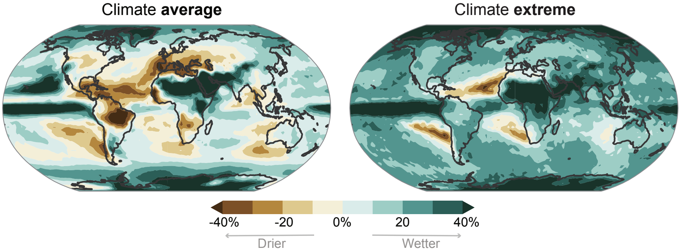
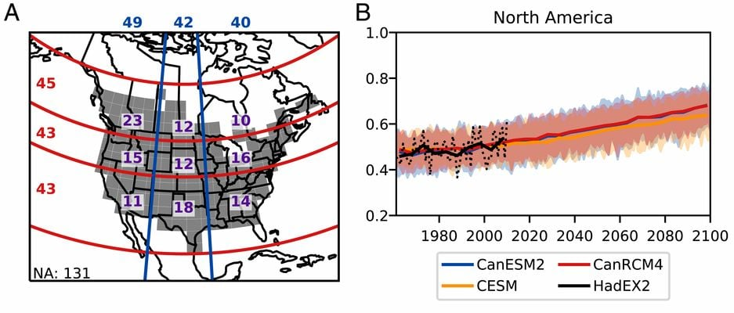
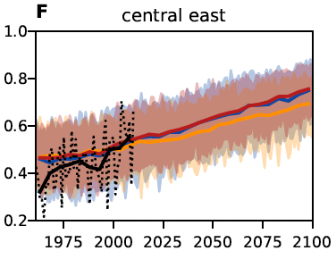
Analyzing Extreme Precipitation Events in Bloomington Using Generalized Extreme Value Regression
Future changes in extreme precipitation
(Kirchmeier-Young et al., 2020, PNAS)
(IPCC, 2021)
Fig. Future changes in averages and extremes precipitation (Rx1day)
Fig. Observed and projected trends in Rx1day
Observed and projected changes
Extreme precipitation increases more than average precipitation
Future trends show an increase in Rx1day precipitation
Notes:
In the future, the frequency and intensity of extreme precipitation events will continue to increase.
The left figure compares the intensity of extreme precipitation with average precipitation, clearly showing a greater increase in extreme precipitation intensity.
The right figure shows the predictions for future trends in extreme precipitation based on different datasets, yielding the same results.

Slide 9
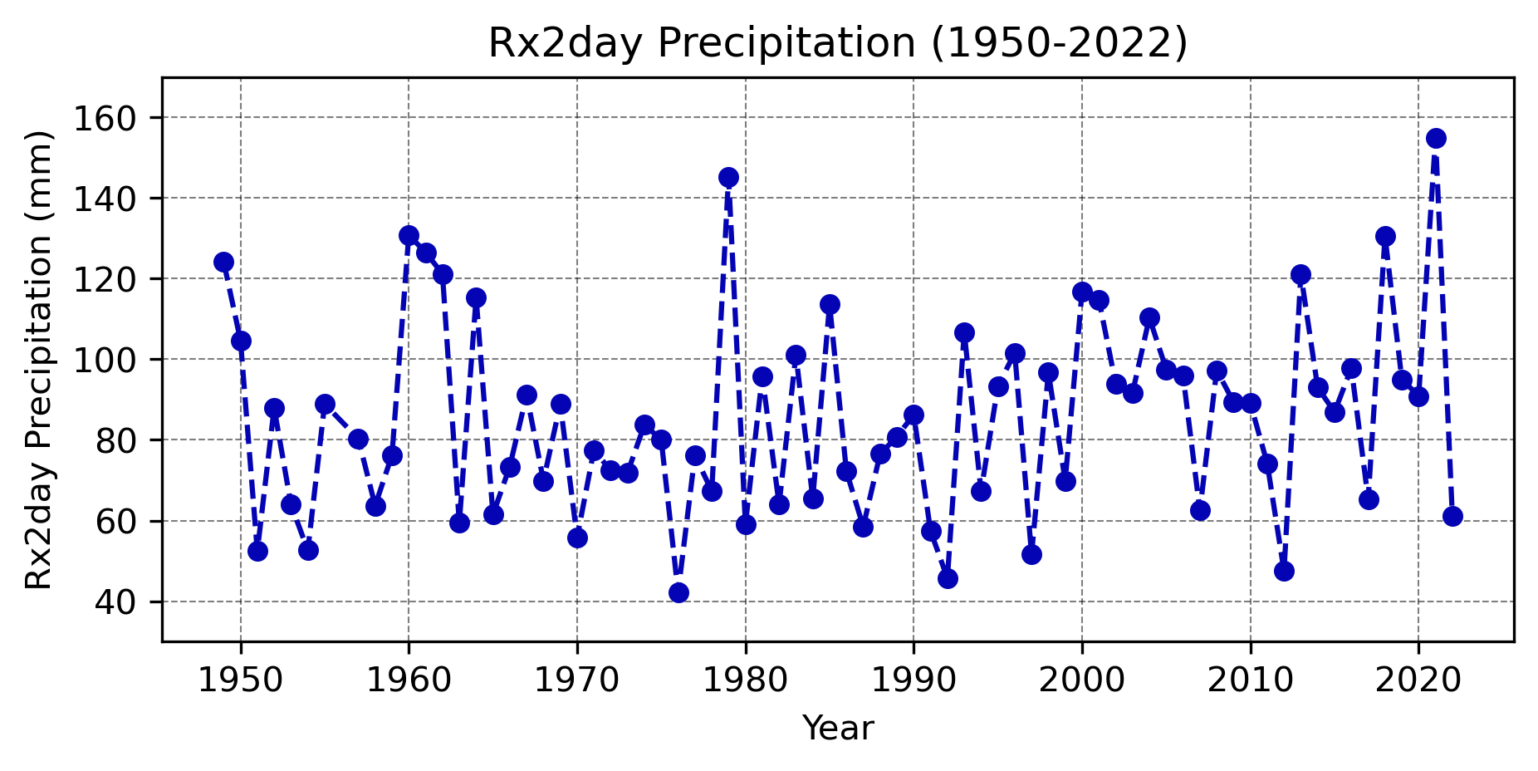
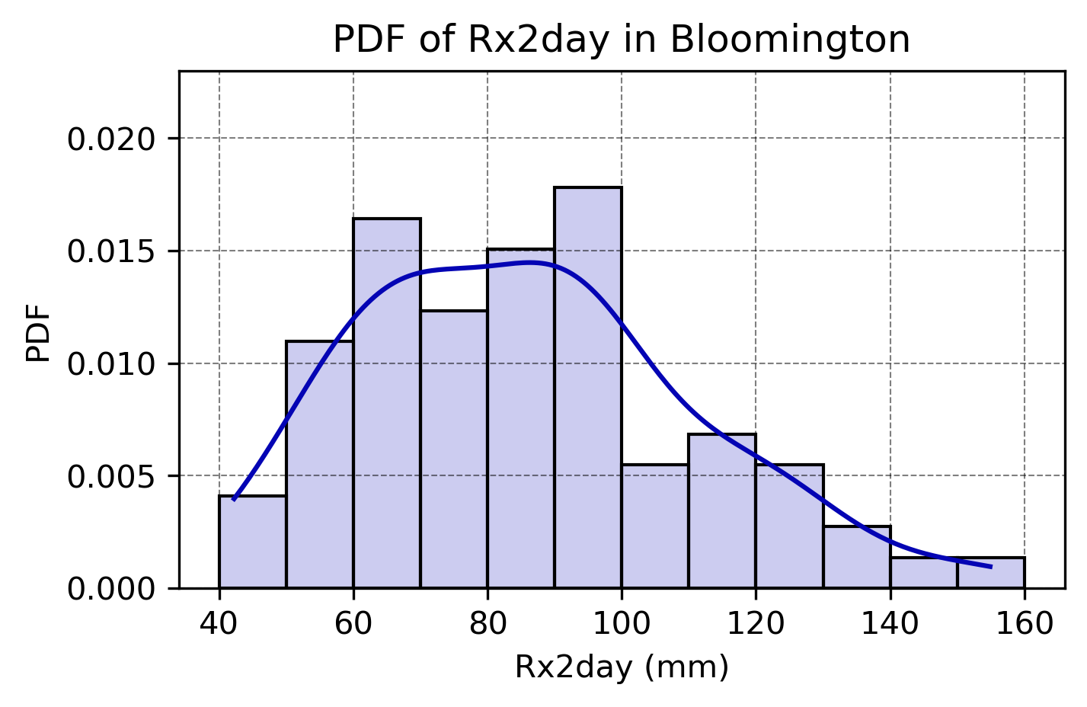
Analyzing Extreme Precipitation Events in Bloomington Using Generalized Extreme Value Regression
Historical records of extreme precipitation and flooding in Bloomington 2021
2021
154.9 mm
Data source
IU station (1895-2022)
focusing primarily on 1950-2022
with comparisons to 1895-2022
Precipitation characteristics
Two-day rainfall reached 154.9 mm
Strongest precipitation event in a century
Trend analysis is inconclusive
2021
Notes:
This is the background on the extreme precipitation in Bloomington for 2021. We got the data from IU station, and as mentioned, 2021 had the strongest precipitation in a hundred years. We used data from 1950 to 2022 for the analysis, and we plan to compare this with data from 1895 to 2022 later on.

Slide 10
Analyzing Extreme Precipitation Events in Bloomington Using Generalized Extreme Value Regression
Generalized Extreme Value (GEV) Regression
The central to D&A methodologies
Evaluating changes in the probability of extreme events (change of μ, σ, ξ).
Attributing causes of changes in extreme events
Projecting future risks of extreme events
The valid statistical conditions for the GEV method
Independent and Identically Distributed
Sufficiently Long Time Series
Block Maxima Method
Parameter Stability Assumption
Comparison with the Central Limit Theorem
Characteristic | Generalized Extreme Value | Central Limit Theorem
Focus | Extremes (max/min values) | Mean or sum of data
Core Theory | Extremes converge to GEV distribution | Sample means approach normal distribution
Scope | Extreme phenomena (e.g., rainfall, temperature) | Central tendency of populations
Distribution | Converges to GEV (Weibull, Gumbel, Fréchet) | Converges to normal distribution
Use | Analyzing frequency, intensity of extremes | Describing mean, confidence intervals
Notes:
The Generalized Extreme Value (GEV) regression is great for studying rare events like Bloomington's 2021 heavy rainfall because it focuses specifically on the biggest and smallest values, which are often the most important in weather studies. It works well because it uses long-term data to predict how often these extreme events can happen and how severe they might be. We don't use the Central Limit Theorem (CLT) for this because CLT is better for analyzing average situations, not the rare or extreme cases that GEV handles so well.

Slide 11
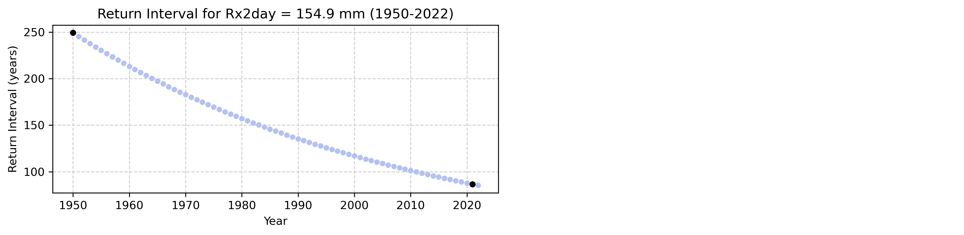
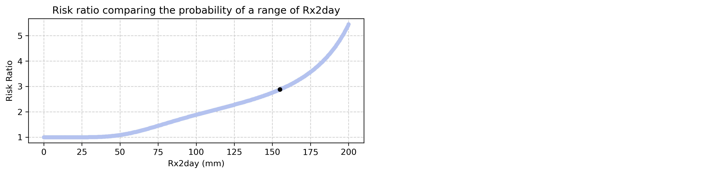
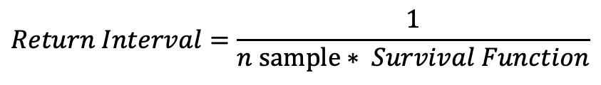
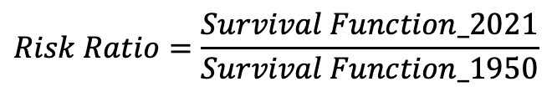
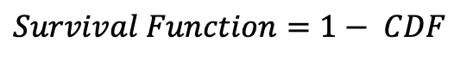
Analyzing Extreme Precipitation Events in Bloomington Using Generalized Extreme Value Regression
Return interval and risk ratio of the event
$$Survival Function=1− CDF$$
$$Return Interval=\frac{1}{n sample∗ Survival Function}$$
RI = 249
Rx2day return interval
Return Interval for Rx2day 2021: 86.57 years
Return Interval for Rx2day 1950: 249.36 years
RI = 87
$$Risk Ratio=\frac{Survival Function_2021}{Survival Function_1950}$$
When Rx2day = 154.9
RR = 2.88
Rx2day risk ratio
The risk ratio is 2.88
Stronger precipitation, faster risk ratio increase
Notes:
Analyses using non-stationary GEV regression on data from 1950 to 2022 estimated the 2021 event's recurrence interval at 86.57 years, compared to 249.36 years in 1950, indicating a significant shortening over the past 70 years.

Slide 12
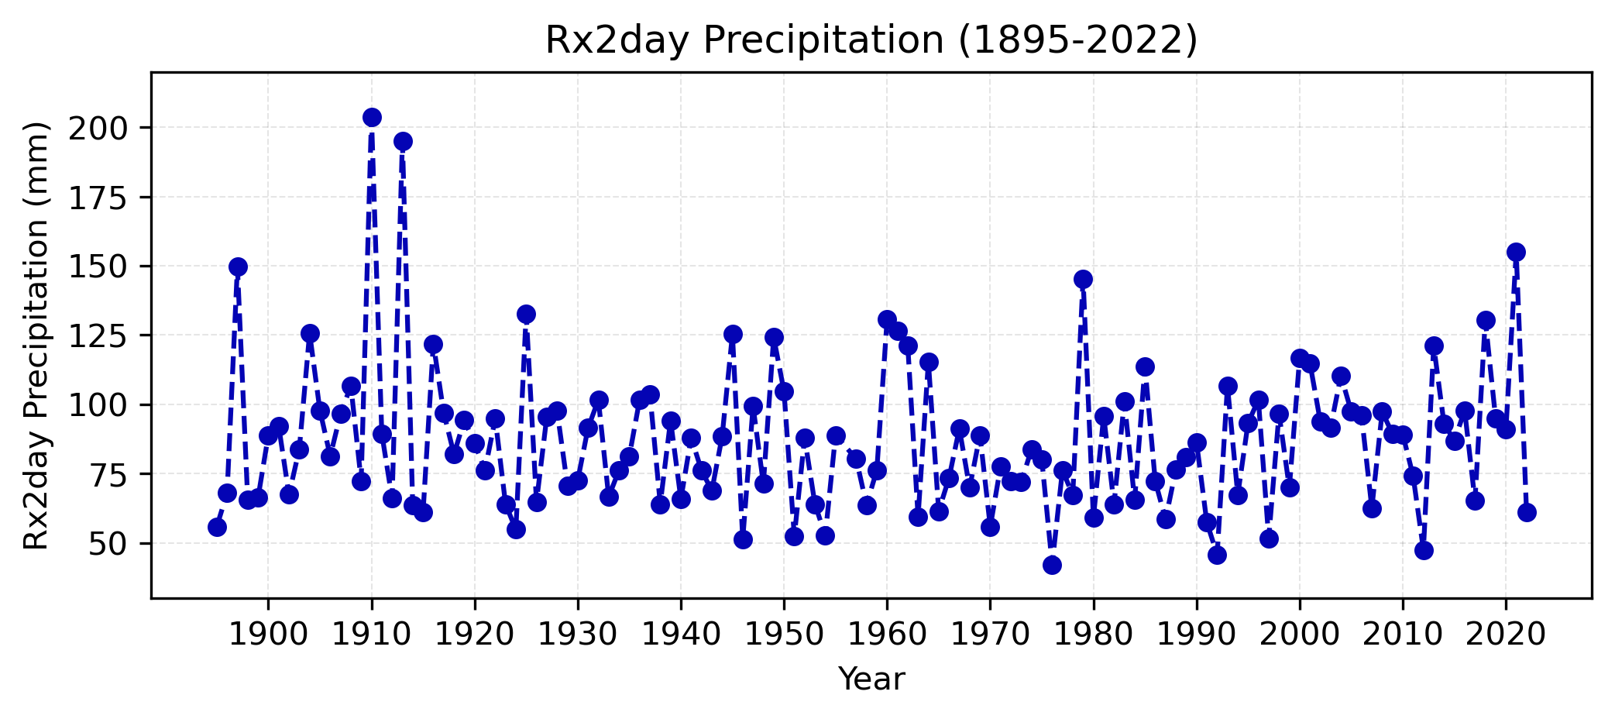
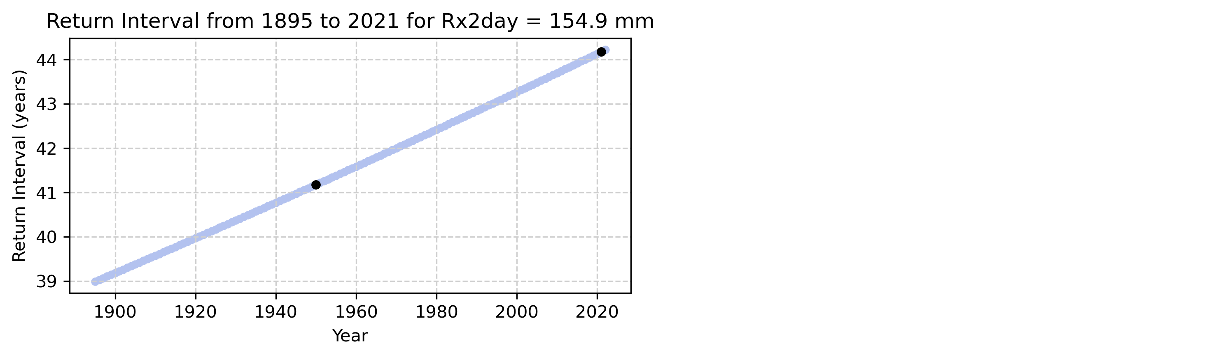
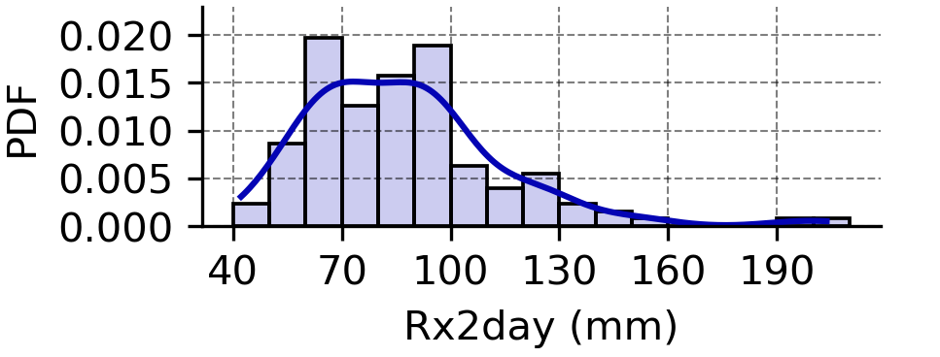
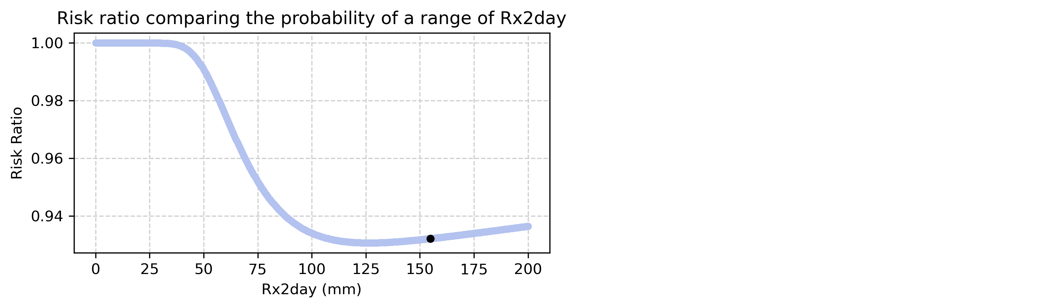
Analyzing Extreme Precipitation Events in Bloomington Using Generalized Extreme Value Regression
Discussion and Compared to the period 1895-2022
Rx2day return interval
Return Interval for Rx2day 2021: 46.65 years
Return Interval for Rx2day 1950: 43.49 years
Rx2day risk ratio
The risk ratio is 0.93
The risk is now lower than it was in the past
Notes:
Analysis from 1985 to 2022 showed a recurrence interval of 46.65 years for 2021, compared to 43.49 years for 1950, influenced by two extreme events in the early 20th century that each recorded about 7.8 inches over two days.
These results show how important it is to pick the right time series data. Shorter time series better reflect today's climate risks, while longer ones might be skewed by old extreme events. It's crucial to choose the right data for your study and be careful with how you interpret the results to avoid mistakes from data bias.

Slide 13
Analyzing Extreme Precipitation Events in Bloomington Using Generalized Extreme Value Regression
Summary
Extreme Precipitation Trend
Confirmed rise across various datasets.
Human Impact
Clear evidence of altered precipitation patterns due to increased GHGs and aerosols.
Increased Frequency and Intensity
Predictions show ongoing rises in extreme precipitation.
GEV Regression Effectiveness
Proven robust in providing precise estimates for extreme events.
Recent Analysis
70-year data shows a 2.8 time increase in risk ratio.
Data Comparison Needs
Future studies should justify the selected time series.
Notes:
Overall, most studies now show that human activities are increasing extreme rainfall events. Analysis using non-stationary GEV regression based on 70 years of data shows that the risk in Bloomington is now 2.8 times higher than before. Future research needs to keep improving these methods to better understand and predict extreme weather patterns.

Slide 14
Analyzing Extreme Precipitation Events in Bloomington Using Generalized Extreme Value Regression
Reference
AMS (2024) Mesoscale convective system glossary of meteorology. Available at: https://glossary.ametsoc.org/wiki/Mesoscale_convective_system
Askins, D. (2021) Photos: Kirkwood flood of 2021, The B Square. Available at: https://bsquarebulletin.com/2021/06/19/photos-kirkwood-flood-of-2021/
Davenport, F. V., & Diffenbaugh, N. S. (2021). Using machine learning to analyze physical causes of climate change: A case study of US Midwest extreme precipitation. Geophysical Research Letters, 48(15), e2021GL093787.
Kirchmeier-Young, M. C., & Zhang, X. (2020). Human influence has intensified extreme precipitation in North America. Proceedings of the National Academy of Sciences, 117(24), 13308-13313.
Legan, M. (2022) One year later: Clear Creek residents worry about future flooding, News - Indiana Public Media. Available at: https://indianapublicmedia.org/news/a-year-later,-clear-creek-residents-worry-about-future-flooding.php.
McGerr, P. (2021) Downtown Bloomington businesses, area residents deal with flooding damage, Times. Available at: https://www.heraldtimesonline.com/story/news/2021/06/19/weather-bloomington-indiana-flooding-kirkwood-flood-damage/7755070002/
NOAA (2021). Available at: https://www.weather.gov/
Papalexiou, S. M., & Montanari, A. (2019). Global and regional increase of precipitation extremes under global warming. Water Resources Research, 55(6), 4901-4914.
Richard D. (2021) USA—Deadly Flash Floods in Bloomington, Indiana. Available at: https://floodlist.com/america/usa/flash-floods-indiana-june-2021
Risser, M. D., Collins, W. D., Wehner, M. F., O’Brien, T. A., Huang, H., & Ullrich, P. A. (2024). Anthropogenic aerosols mask increases in US rainfall by greenhouse gases. Nature Communications, 15(1), 1318
Risser, M. D., & Wehner, M. F. (2017). Attributable human‐induced changes in the likelihood and magnitude of the observed extreme precipitation during Hurricane Harvey. Geophysical Research Letters, 44(24), 12-457.
Seneviratne, S. I., Zhang, X., Adnan, M., Badi, W., Dereczynski, C., Luca, A. D., ... & Allan, R. (2021). Weather and climate extreme events in a changing climate.
Travis O'Brien (2021) Bloomington Flood statement. Available at: https://earth.indiana.edu/news-alumni/department-news/archive/2021/2021-bloomington-flood.html
https://github.com/Gong001/EAS-G-577/blob/main/major_assignment_GG.ipynb
Notes:
These are the references used in this study.
The code can be found on this website.

